Slide 1
EOSC Portal Services towards Providers
George Papastefanatos, University of Athens

Slide 2
providers.eosc-portal.eu
What you can do in the new Provider’s section of the EOSC Portal

Slide 3
providers.eosc-portal.eu
Onboarding of Resources
Self service, Workflow based

Slide 4
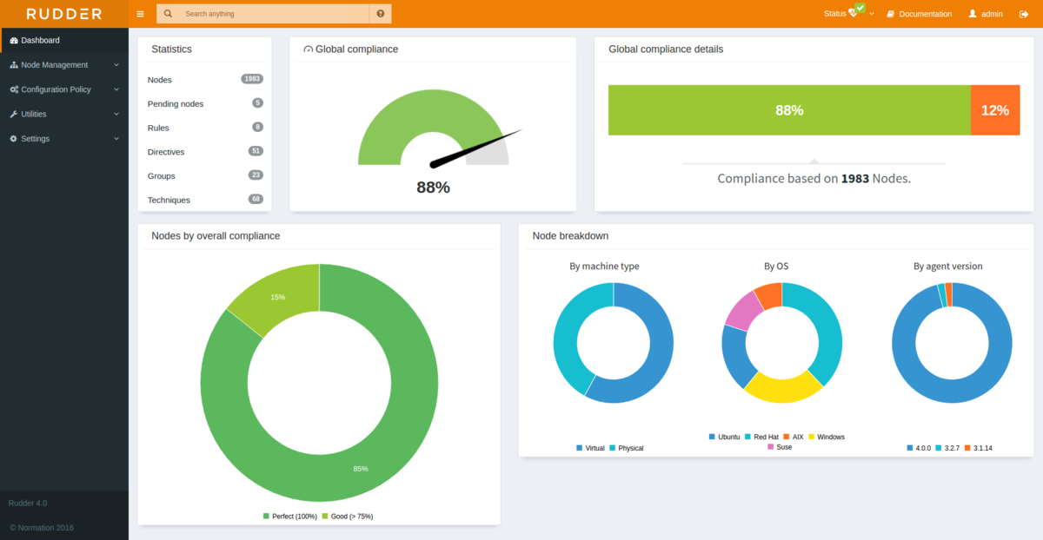
providers.eosc-portal.eu
Provider Dashboard
Gain full control of your resources in the catalogue

Slide 5
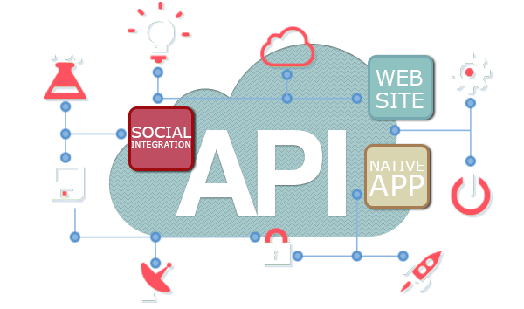
providers.eosc-portal.eu
Application Programming Interfaces (APIs)
Programmatic management of resources

Slide 6
Overview of EOSC Portal Onboarding Process

Slide 7
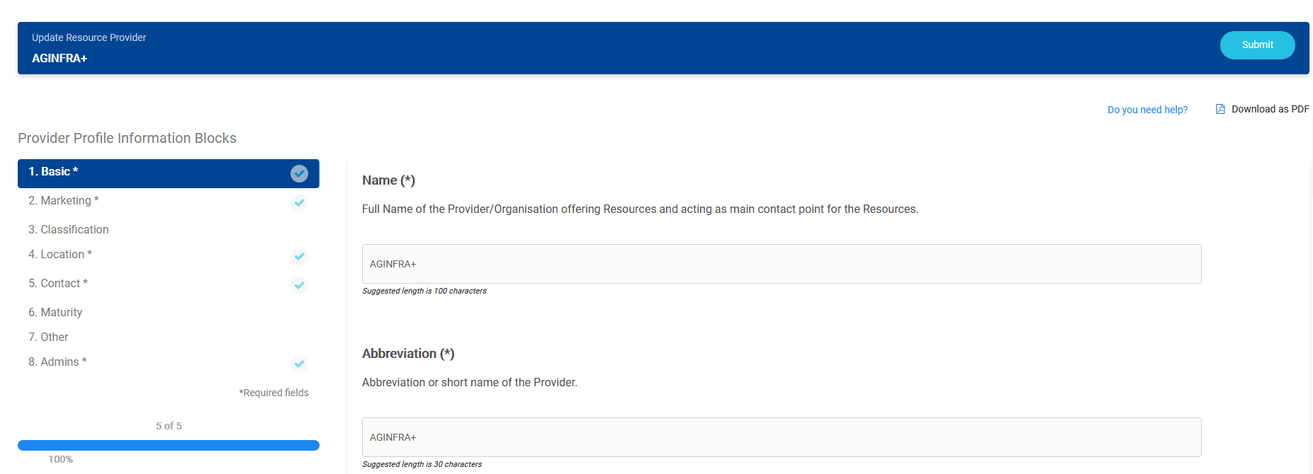
Onboard the Provider
The Provider Profile is organised in information blocks
All mandatory fields (denoted with *) have to be filled in.
Need to press the Submit button to finalize the Provider application.
The Provider Profile Template is also offered for download and preview
In case of difficulties during Provider onboarding communicate to onboarding@eosc-portal.eu
Send feedback by creating a ticket

Slide 8
The EPOT reviews and approves the Provider Profile
The Provider Profile is reassessed following the same process.
When the Provider Profile complies with the minimum requirements, the representative is notified by email from the EOSC Portal.
The EPOT updates the status in the Jira ticket.
The Provider is now registered to the EOSC portal as a new Provider.

Slide 9
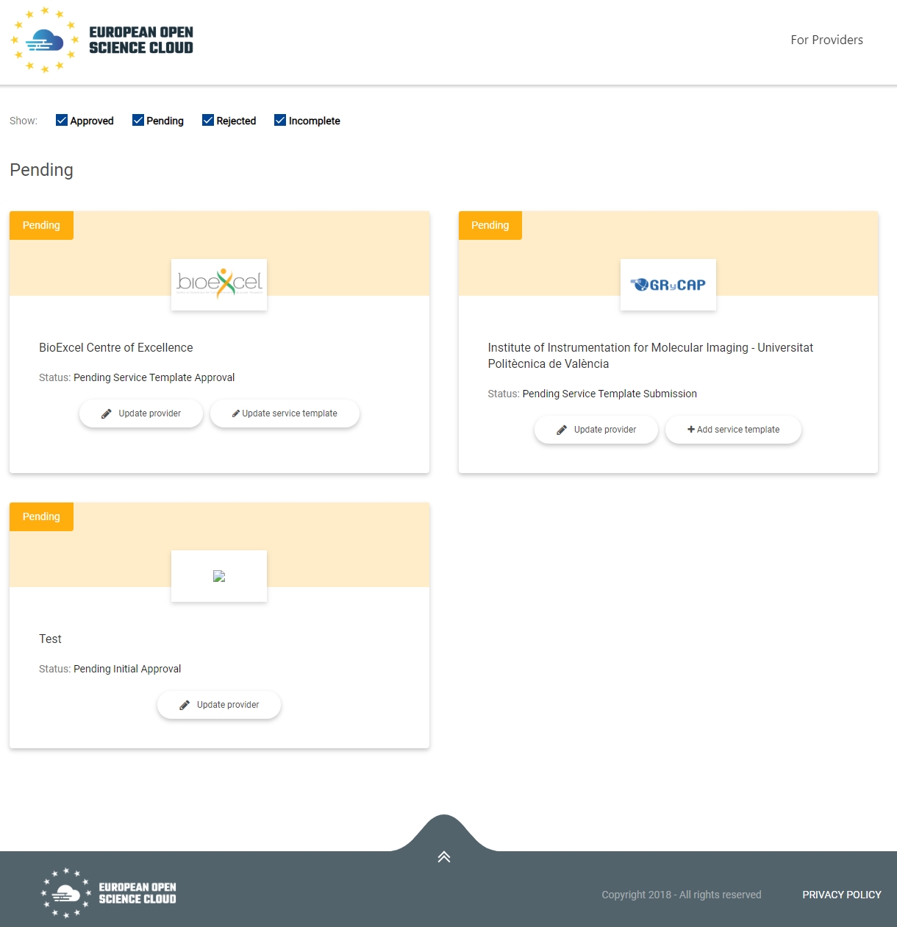
Onboard Resources
Two options to onboard Resources:
a) via a web interface for each Resource individually
b) via the EOSC Portal Application Programming Interface (API).
For Onboarding with the EOSC Portal API follow the “EOSC Portal API Tutorial”.

Slide 10
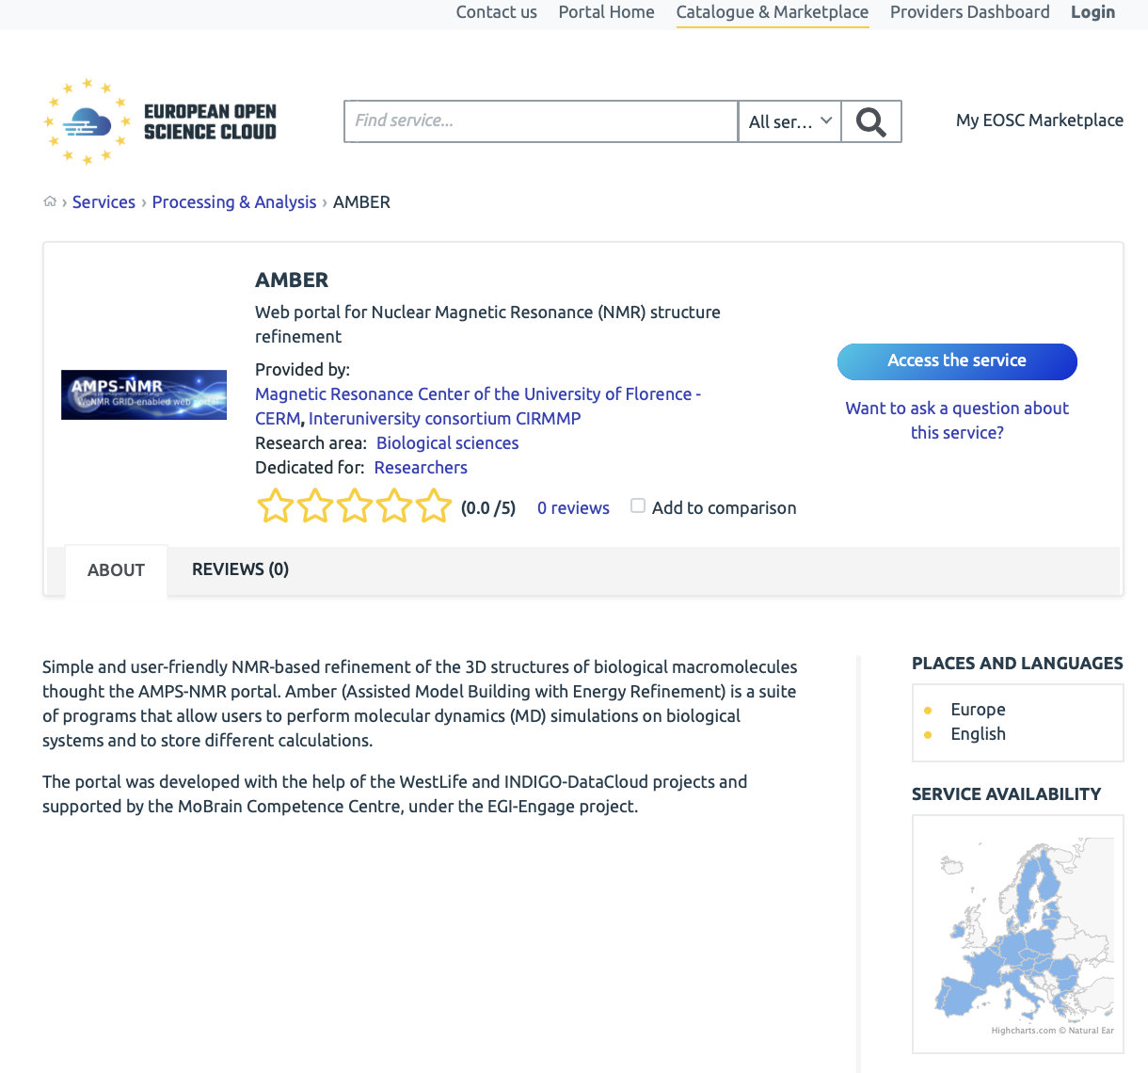
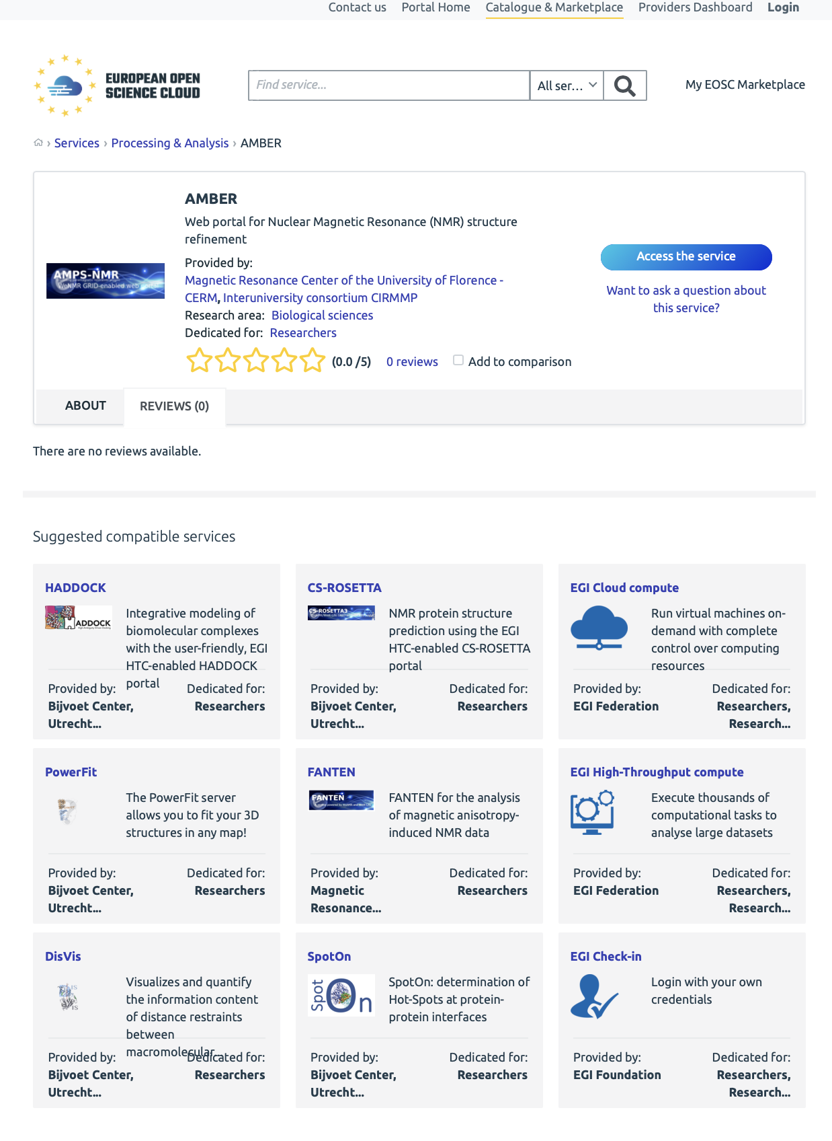
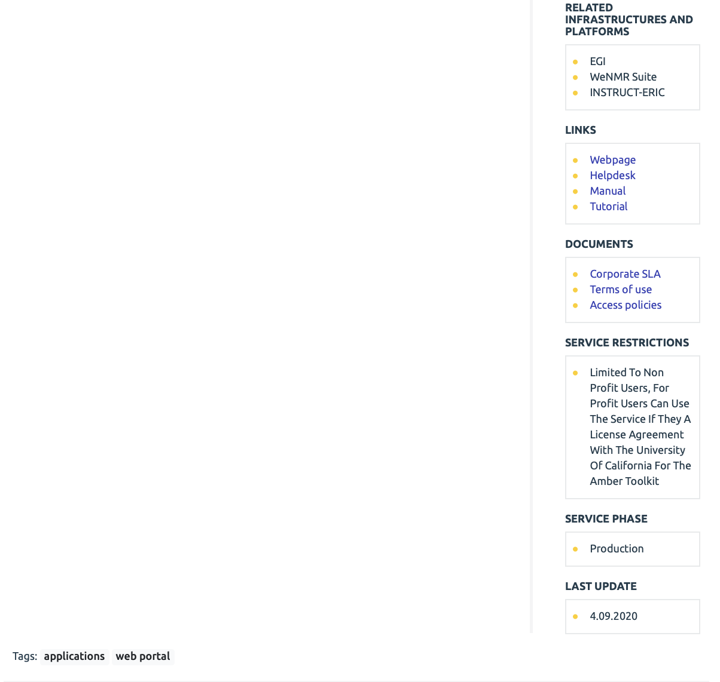
The EPOT reviews and approves the Resource Profile

Slide 11
EOSC Provider Dashboard
George Papastefanatos, University of Athens

Slide 12
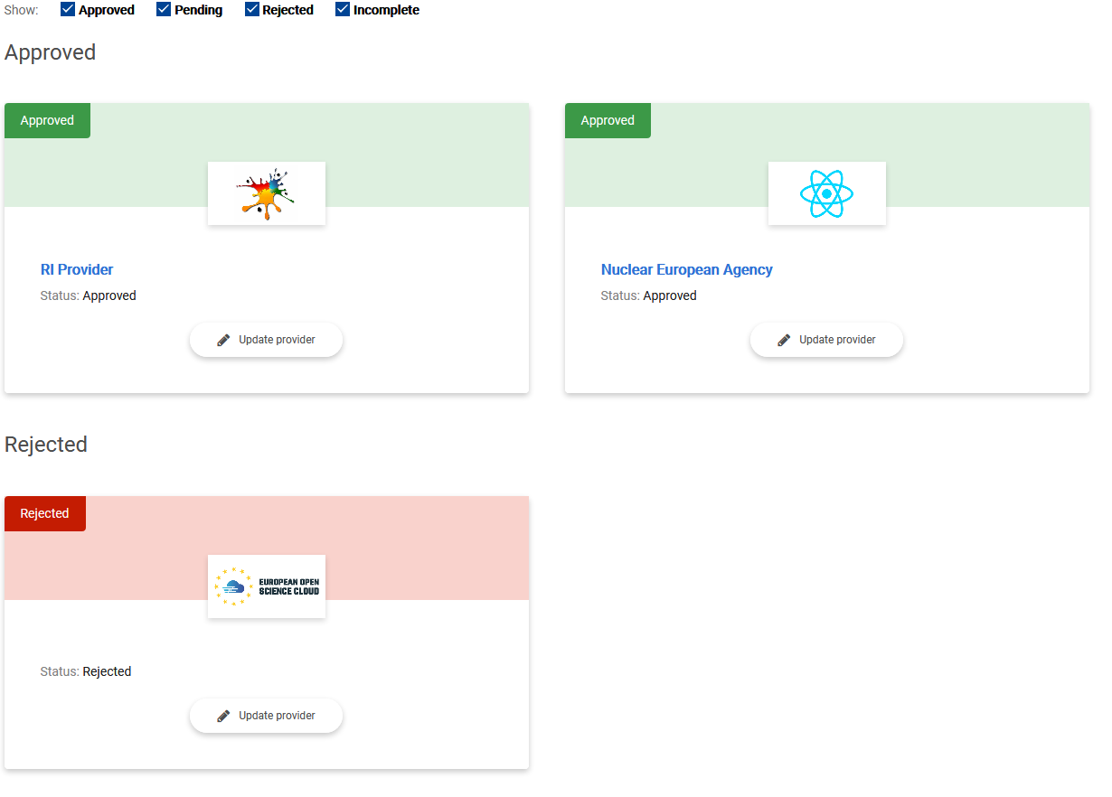
EOSC Provider Dashboard - Overview
All providers managed by the user in a single place.
Status of each application
Filter
Update information

Slide 13
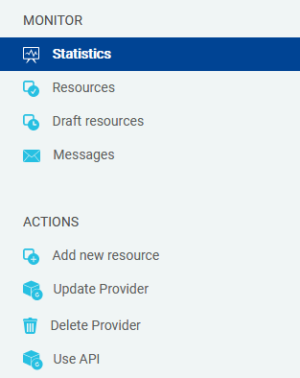
EOSC Provider Dashboard - Actions
The Representative is able to perform various actions on the Provider Dashboard:
View statistics for
Aggregated by all providers’ resources
Aggregated by resource
View the list of resources
Public
Draft
Update the Provider Profile: Update the information regarding the organisation.
Update resources
Add New Resources

Slide 14
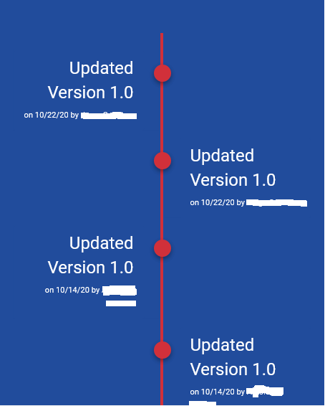
User activity tracked – Providers
Basic Web analytics (Page visits)
Onboarding activity
Login, logout
New application submitted
Resource management activity
Add \ update \ delete actions
Deactivate,
New version

Slide 15
Overview of the EOSC Portal API

Slide 16
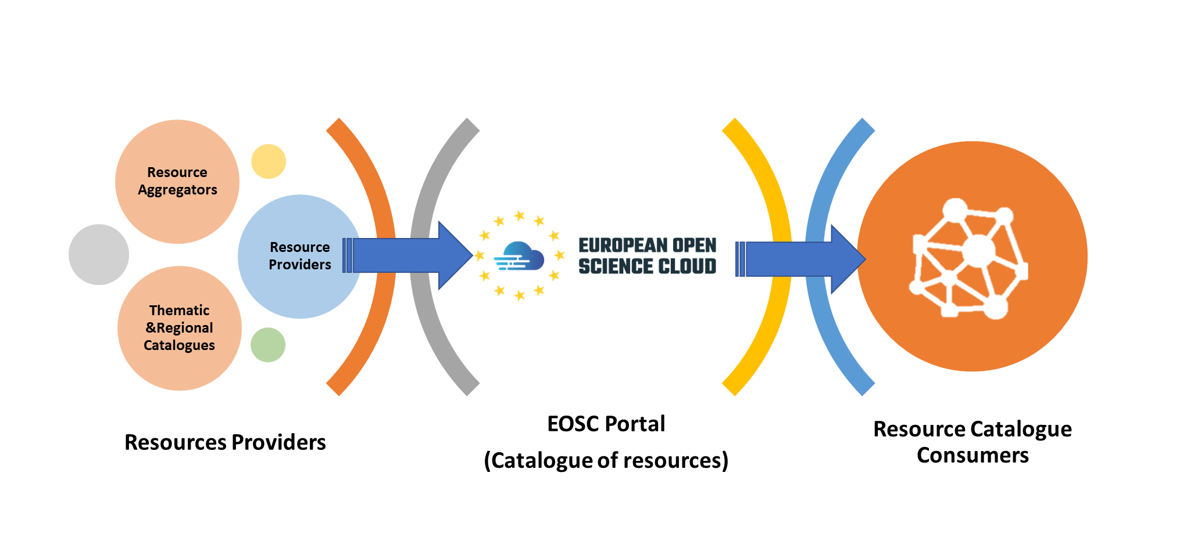
Application Programming Interfaces

Slide 17
How to use the EOSC Portal API
To activate the EOSC Portal API, three steps should be implemented in sequence:
The Representative onboards the Provider and one Resource at the EOSC Portal Web Interface.
The Representative obtains an EOSC Portal API token to be used for authorization.
The Provider organization uses the API methods ^{[1]} to create, update or retrieve content from the EOSC Portal.
^{[1]} Details of the methods at https://providers.eosc-portal.eu/openapi

Slide 18
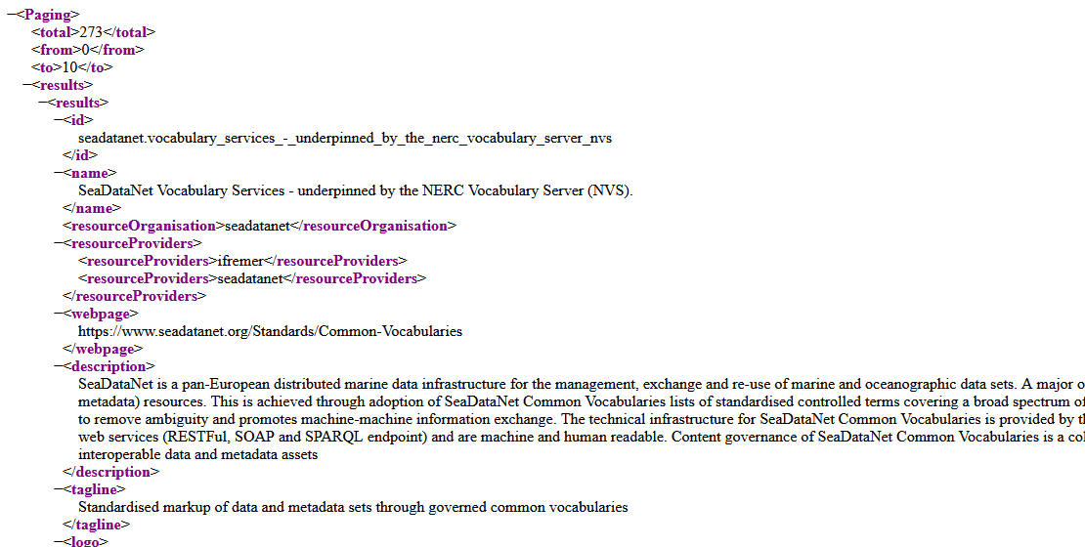
Using the API methods
EOSC Portal APIs documentation https://providers.eosc-portal.eu/openapi
EOSC Portal APIs
Use SSL - https://
EOSC Portal APIs Base URLs
https://api.eosc-portal.eu/
{Base URLs}/{method}
https://api.eosc-portal.eu/resource/all
https://api.eosc-portal.eu/resource/all

