Slide 1


EOSC Portal
Specifications & Supporting Tools for Providers and Future Plans
Dr. Jorge-A. Sanchez-P. - JNP

Slide 2
Overview
EOSC Portal Definitions
EOSC Portal Functional and Non-Functional Requirements v.2020
EOSC Portal Profiles v3.00
EOSC Portal Onboarding Process v3.00
Migration Process to v3.00and Merging of EOSC Portal Registries
EOSC Portal Onboarding Operations v3.00
EOSC Portal Monitoring Portal v3.00
EOSC Portal Tutorial Modules v3.00
EOSC Portal Documentation
Future Plans

Slide 3
Definitions

Slide 4
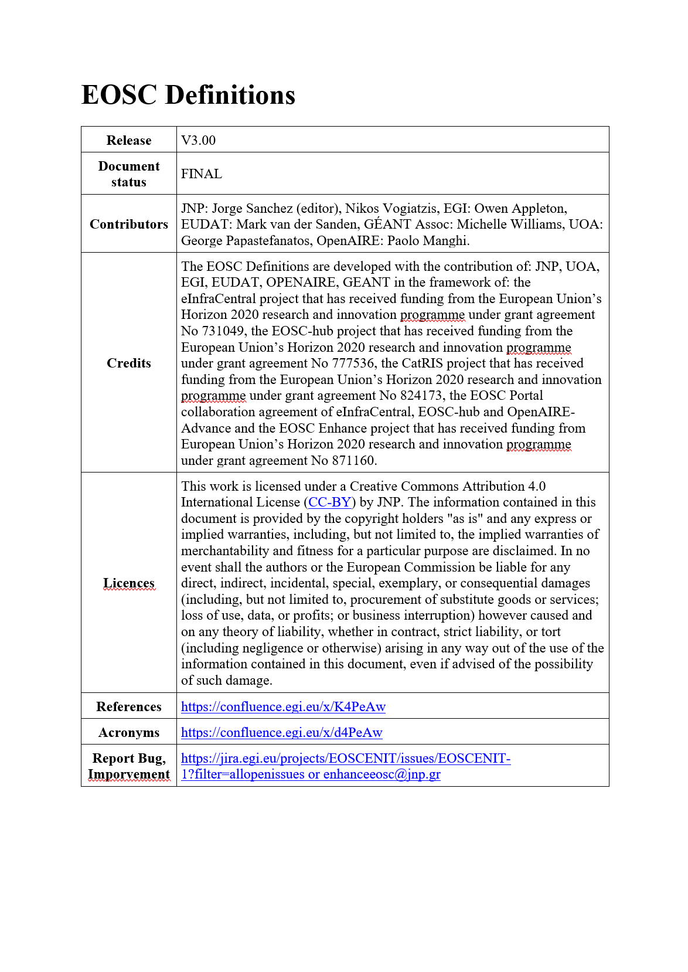
EOSC Portal Definitions
https://confluence.egi.eu/x/coPeAw

Slide 5
Definitions
Term | Definition
EOSC | the European Open Science Cloud promoted by the European Commission to provide all researchers, innovators, companies and citizens with seamless access to an open-by-default, efficient and cross-disciplinary environment for storing, accessing, reusing data, tools, publications and any EOSC Resource for research, innovation and educational purposes. The EOSC is implemented by the EOSC System and governed by EOSC Governance.
EOSC System | the IT system implementing EOSC. Such a system is called to put in place the policies, procedures and technical solutions needed to enact the delivery of the EOSC Services in accordance with the EOSC Governance guidelines. Such a system is not a monolithic, stand-alone and centralised IT system. Rather the EOSC System is designed and developed to be a system of systems.
EOSC Governance | the set of committees and bodies governing the functioning of EOSC and its EOSC System. It includes the EOSC Executive Board, the EOSC Board, and the EOSC Stakeholders Forum.
EOSC Portal | the EOSC Service implementing a web portal facilitating the access to and use of the EOSC Resources. The EOSC portal is the universal access channel through which all European researchers can access, use and reuse research outputs and data across disciplines.
EOSC Registry | an EOSC Service providing EOSC System Users with a list of live/ready-to-use descriptions of EOSC Resources offered by the EOSC System. Every entry of the EOSC Registry must follow and be described and updated following the EOSC Interoperability Framework. The following typologies of the EOSC Registry are currently envisaged: the EOSC Service Registry, the EOSC Data Source Registry and the EOSC Research Product Registry.
EOSC Platform | the collection of internal services and the central EOSC Registry which services content to EOSC Portal and to other EOSC Registries or parts of the EOSC System.
EOSC Resources | any asset made available by means of the EOSC system and according to the EOSC Rules of Participation to EOSC End-Users to perform a process useful to deliver value in the context of the EOSC. EOSC Resources include Services, Data Sources, Research Products and any other asset.
EOSC Service | an EOSC Resource that provides EOSC System Users with ready-to-use facilities. EOSC Services are supplied by an EOSC Service Provider in accordance with the EOSC Rules of Participation. EOSC Services populate the EOSC Service Portfolio and the EOSC Service Catalogue.
EOSC Data Source | an EOSC Resource whose specific purpose is to offer deposition, preservation, curation, discovery, access, and usage statistics functionalities to collections of EOSC Research Products from a thematic or cross-discipline perspective. EOSC Data Sources include Repositories, Scientific Databases, Resource Catalogues, Aggregators, Journals, Publishers, Registries, CRIS systems, and Research Graphs. Repositories support all functionalities above; they are typically used by EOSC Users to share and give access to Research Products. Databases are used to share and give access to Research Products that are not intended as files described by metadata (e.g. big data collections, LOD, time-series databases, geospatial/maps databases, etc.). Resource catalogues offer discovery functionalities over a set of EOSC Data Sources by collecting their metadata collections.
EOSC Research Product | an EOSC Resource that is the result of a research process (e.g. publications, research data, research software, other products) and is made accessible via an EOSC Data Source. Research Products are characterised/described by metadata to be used for citation, attribution, reuse, reproducibility, semantic linking, and findability.

Slide 6
Definitions
Term | Definition
EOSC Portfolio | the internal list of EOSC Resources including those in preparation, live and discontinued.
EOSC System User | the role played by every actor (human or machine) exploiting the EOSC System. An EOSC System User might be further specialised in roles including EOSC End-users, EOSC Providers, EOSC System Managers, etc.
EOSC End-user | an EOSC System User consuming Resources from the EOSC to accomplish a task. EOSC End-users can be Researchers, Research groups, Research communities, Research projects, Research networks, Research managers, Research organisations, Students, Innovators, Businesses, Funders, Policy Makers, etc.
EOSC Provider | an EOSC System User responsible for the provisioning of one or more Resources to the EOSC. EOSC Providers are organisations, a part of an organisation or a federation that manages and delivers Resources to End-Users. EOSC Providers can be Resource Providers, Service Providers, Data (Source) Providers, Service Developers, Research Infrastructures, Distributed Research Infrastructures, Resource Aggregators, Thematic Clouds, Regional Clouds, etc.
EOSC Registry Interoperability Framework | the framework that any EOSC Resource must comply with to be listed in the EOSC Registry. The framework includes, among others the EOSC Profiles, the EOSC Onboarding Process, the EOSC Rules of Participation, and the EOSC Portal Application Programming Interfaces. The framework also defines the workflows, the APIs, the formats, the legal framework, the SLA that similar Registries operated by research infrastructures or clusters must comply to be aggregated by the corresponding EOSC Registries.
EOSC Profiles | the standard scheme for the representation of resource-related information in the EOSC Registry. The following typologies are currently envisaged: the EOSC Provider Profile, the EOSC Resource Profile. The Profiles include structured classifications of various EOSC Registry attributes for their harmonised descriptions.
EOSC Onboarding Process | the process that an EOSC Provider must follow to register the Provider and their resources in the EOSC Registry.
EOSC Rules of Participation | the principles defined by the EOSC Governance to drive the processes enacting an actor to play the role of EOSC System User (and any specialisation of it).
EOSC Portal Application Programming Interfaces | a set of standard APIs that allow for the registration, update, export of EOSC Resource descriptions and related information from the EOSC Registry.
https://confluence.egi.eu/x/coPeAw

Slide 7
Interoperability
EOSC Portal
RI
/Data
Thematic
Regional
eInfra
App/SW/Data
-
Services
Clouds
Clouds
Pipelines
Aggregators
Aggregators
Data/Apps
Aggregators
Aggregators
Aggregators
Profiles
APIs
Distributed Research
Scholarly
Comm
App/SW
Core Facilities
e
Marketplaces
-
Infrastructures
Infra Service
Data
Repositories
Providers
Registries
CF1
CF
DP2
NOAD1
NOAD2
ASP1
ASP2
RI1
RI2
2
SP1
SP3
DP1

Slide 8
EOSC Portal Functional and Non-Functional Requirements v.2020

Slide 9
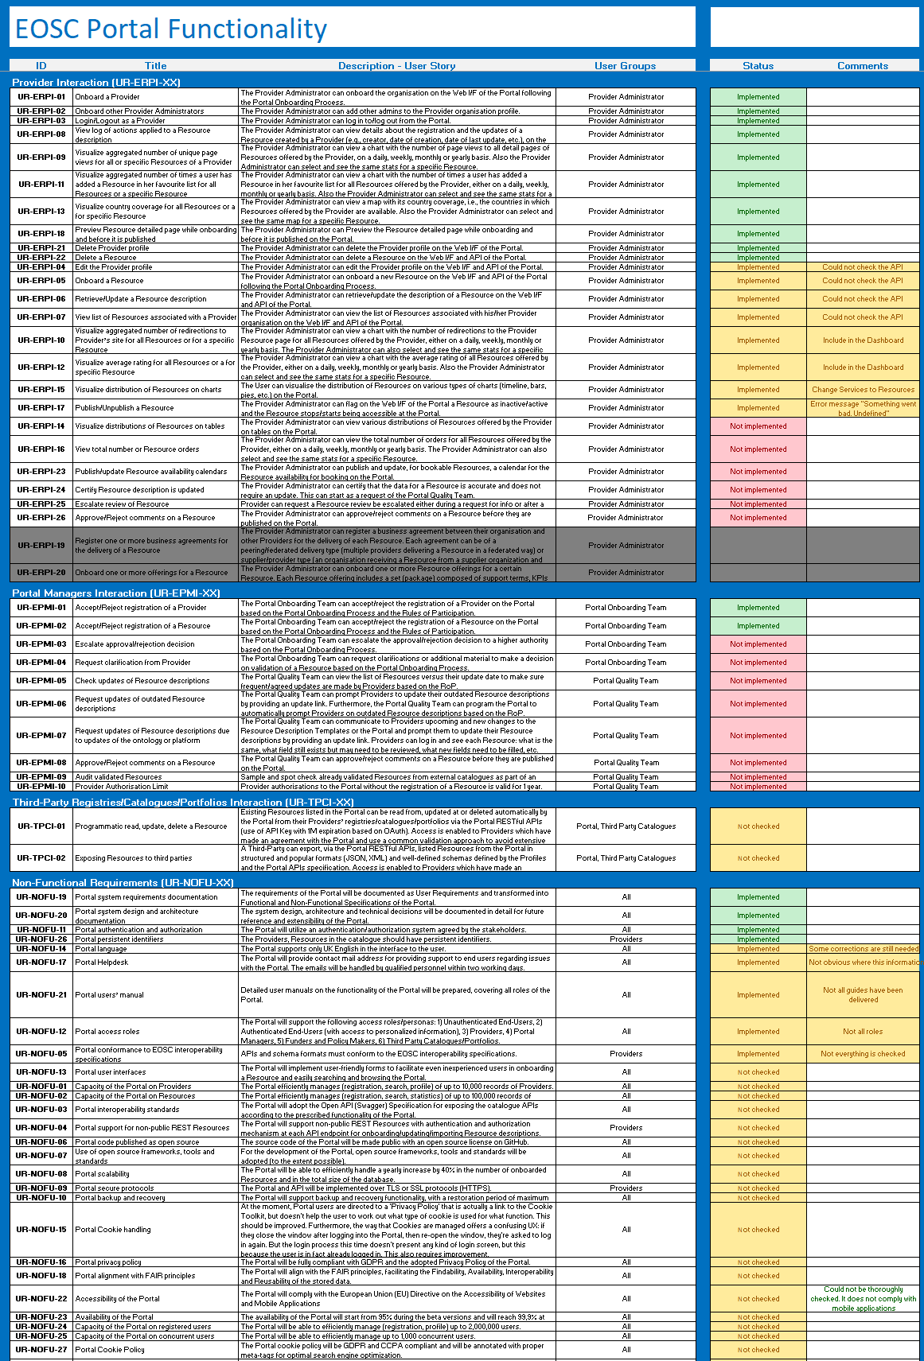
Functional and Non-Functional Requirements
https://confluence.egi.eu/x/JITeAw

Slide 10
EOSC Portal Profiles v3.00

Slide 11
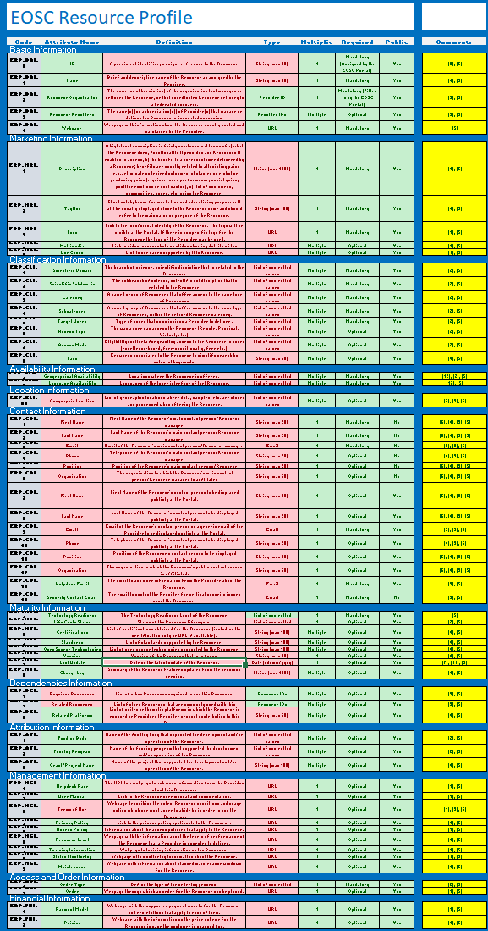
(Provider and Resource) Profiles v3.00
https://confluence.egi.eu/x/s4XeAw

Slide 12
EOSC Portal Onboarding Process v3.00

Slide 13
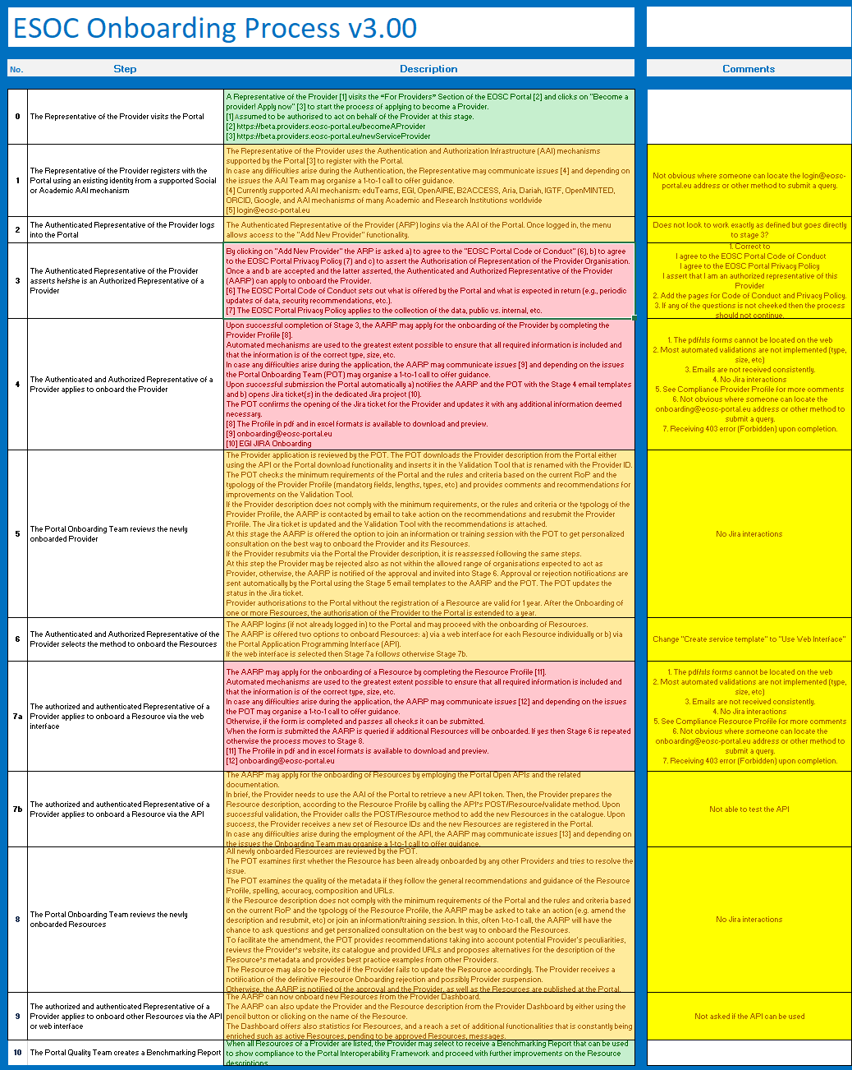
Onboarding Process v3.00
https://confluence.egi.eu/x/2ITeAw

Slide 14
EOSC Portal Catalogue/Registry Migration Process v3.00

Slide 15
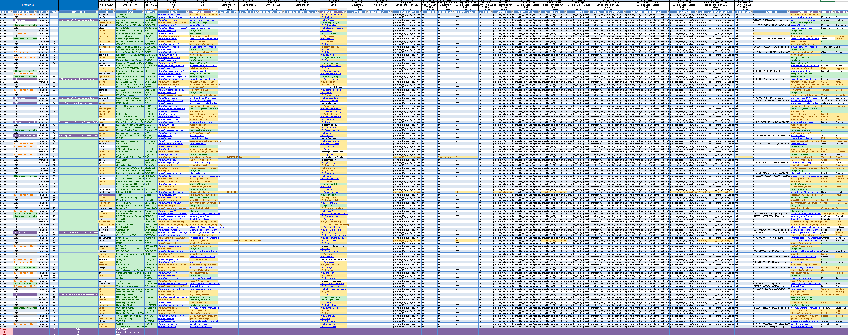
Migration to v3.00 and
Merging of EOSC Portal Registries
https://confluence.egi.eu/x/AgkRB
122 Providers, 280 Resources

Slide 16
EOSC Portal Onboarding Operations v3.00

Slide 17
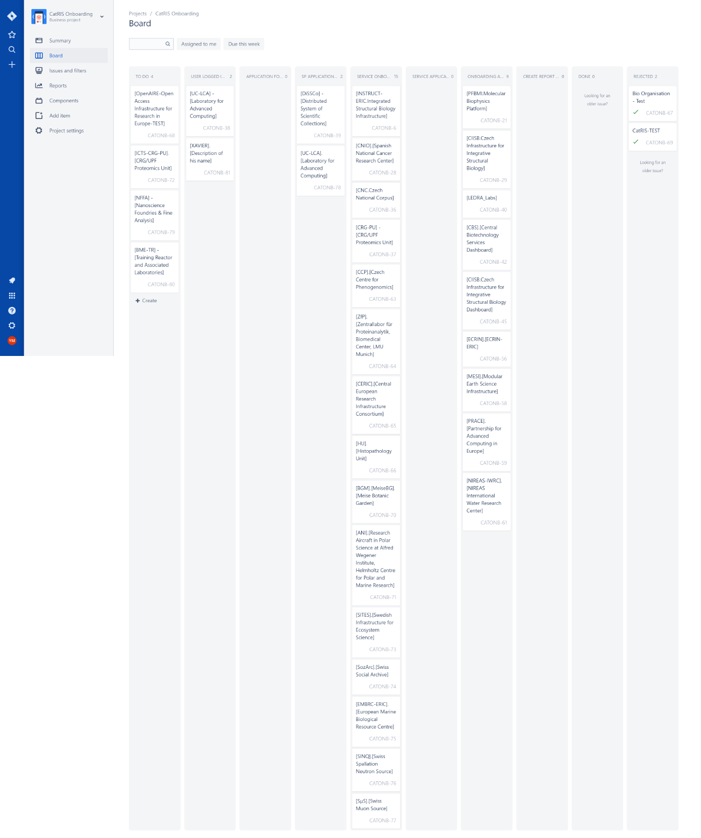
Onboarding Operations
https://confluence.egi.eu/x/AgkRB
122 Providers, 280 Resources

Slide 18
EOSC Portal Monitoring Tool v3.00

Slide 19
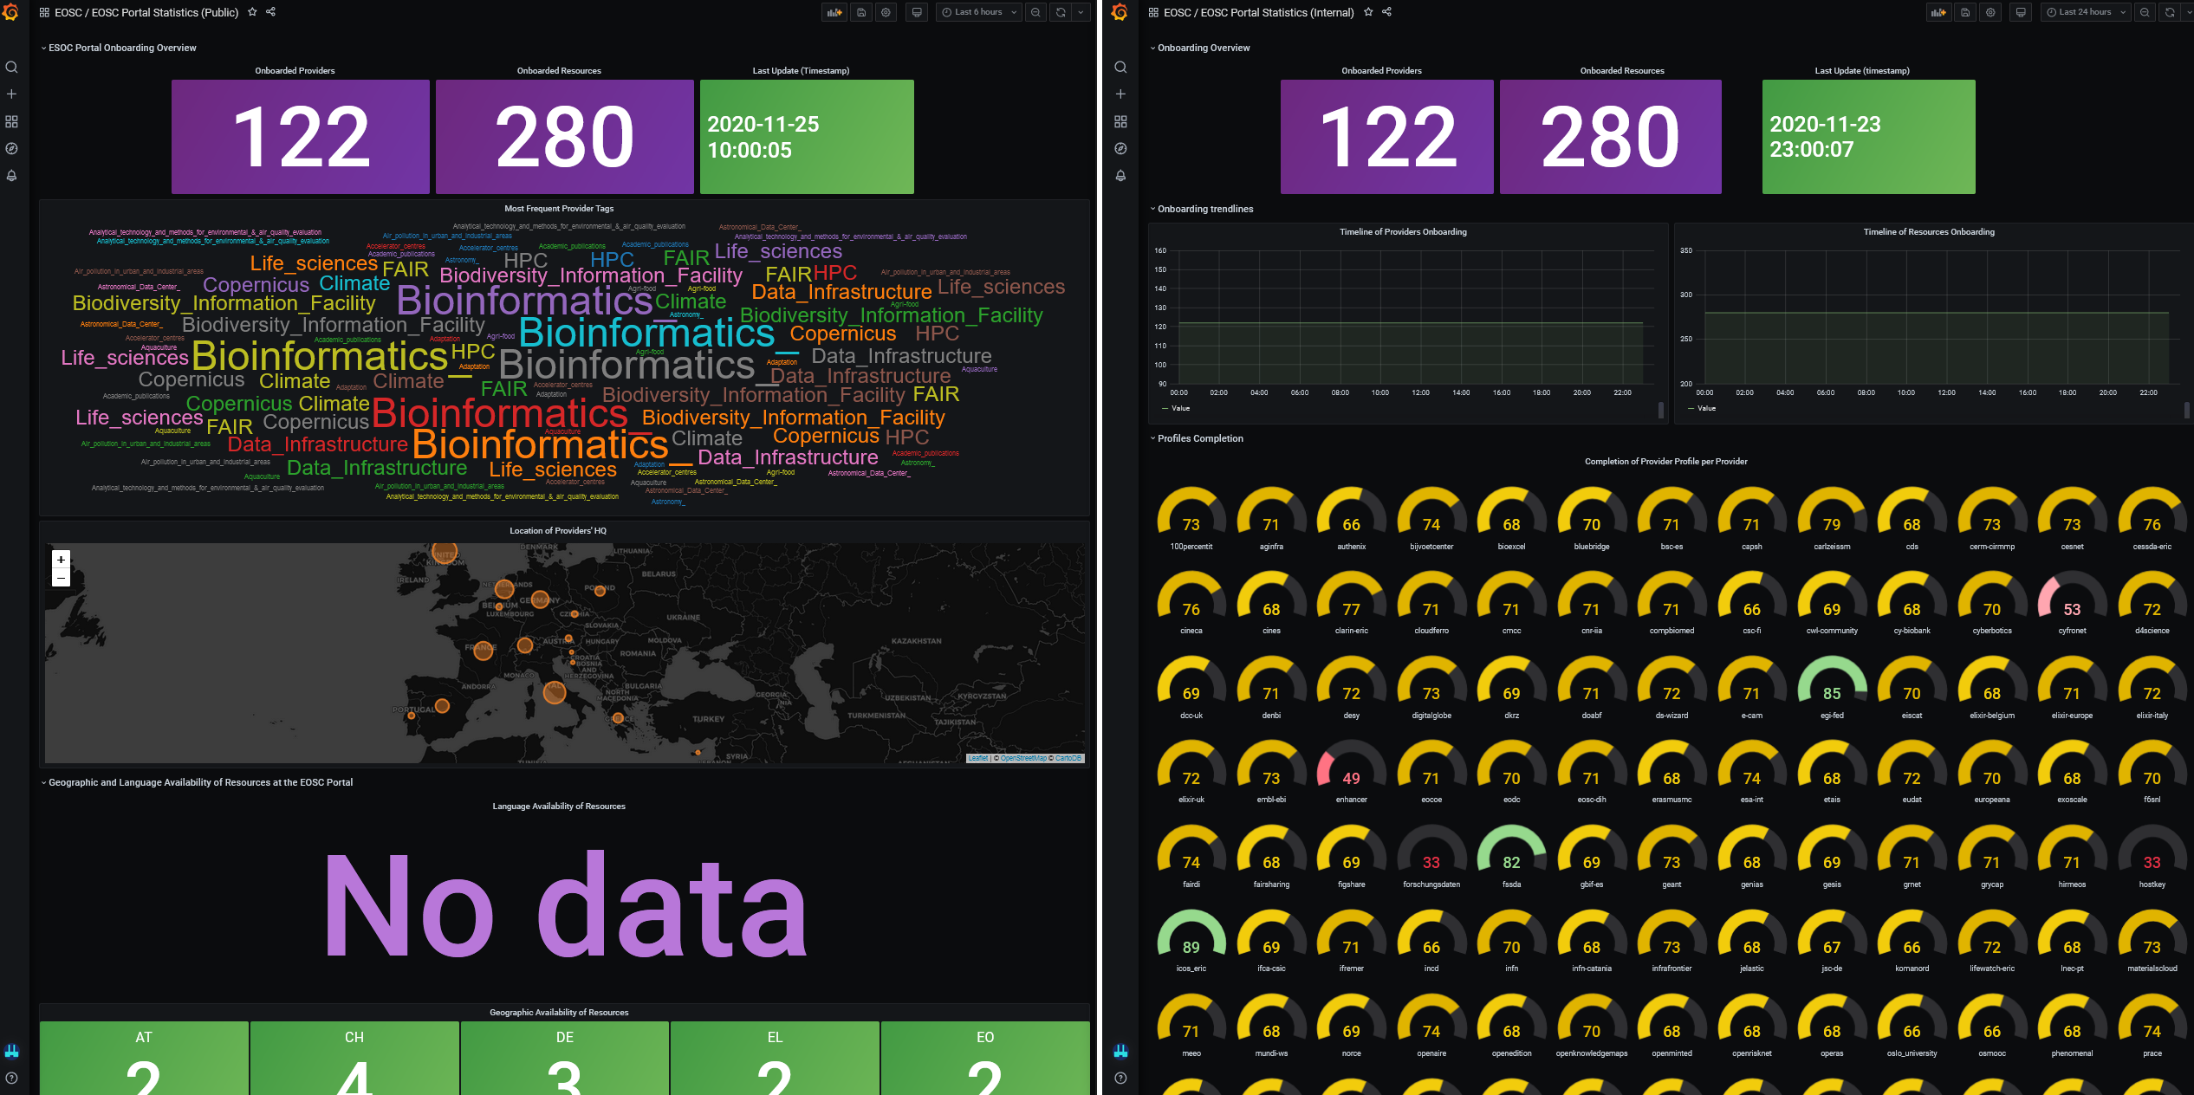
https://stats.jnp.gr/ login: ec-enhance, password: Jvri2exfkCxL

Slide 20
EOSC Portal Tutorials

Slide 21
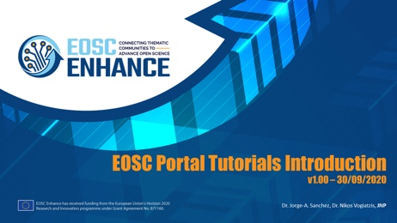
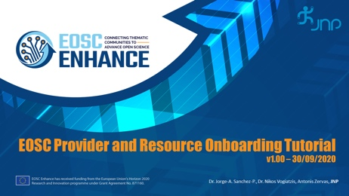
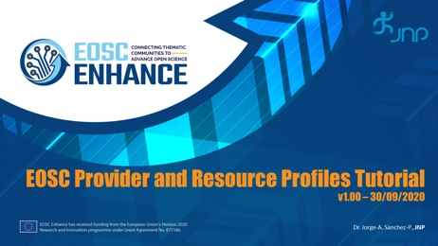

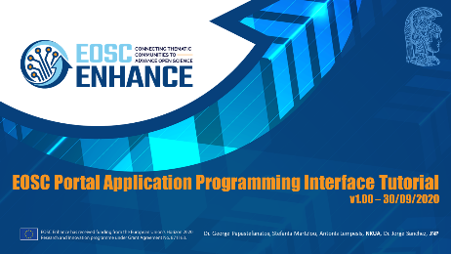
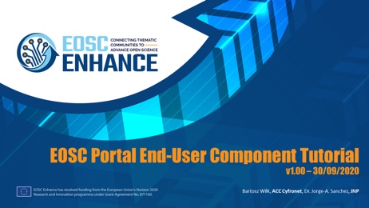
https://www.eosc-portal.eu/using-the-portal

Slide 22
EOSC Portal Documentation

Slide 23
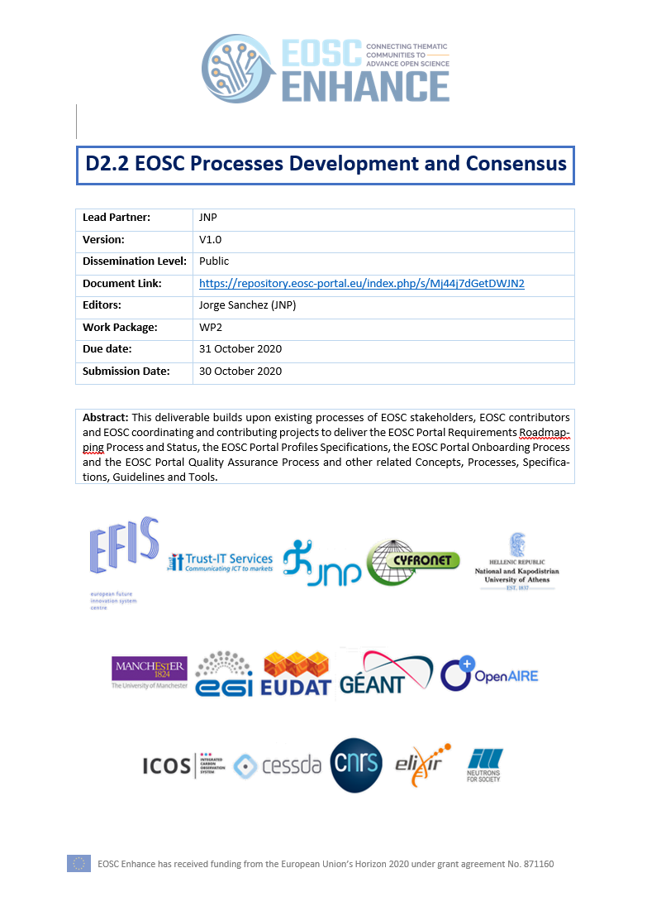
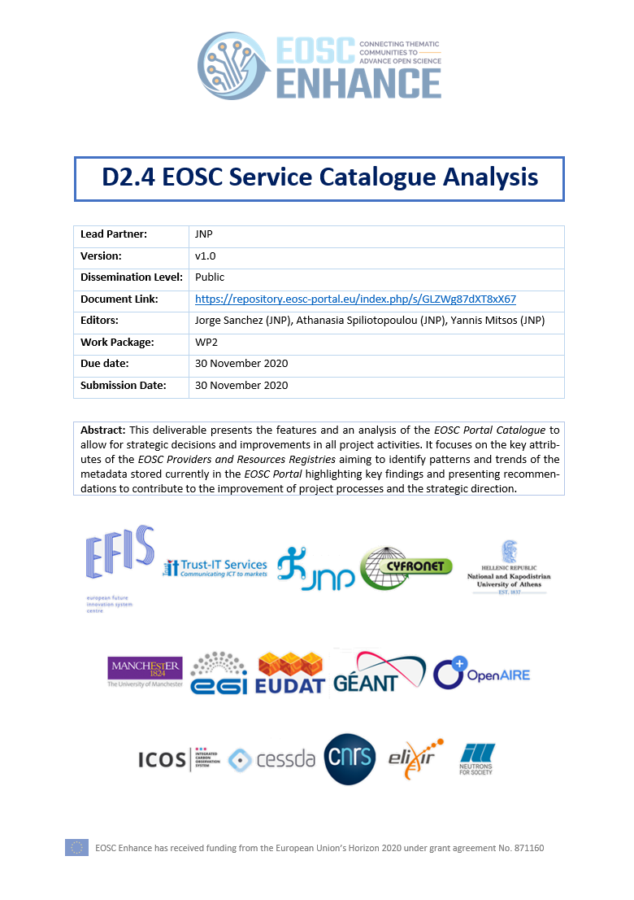
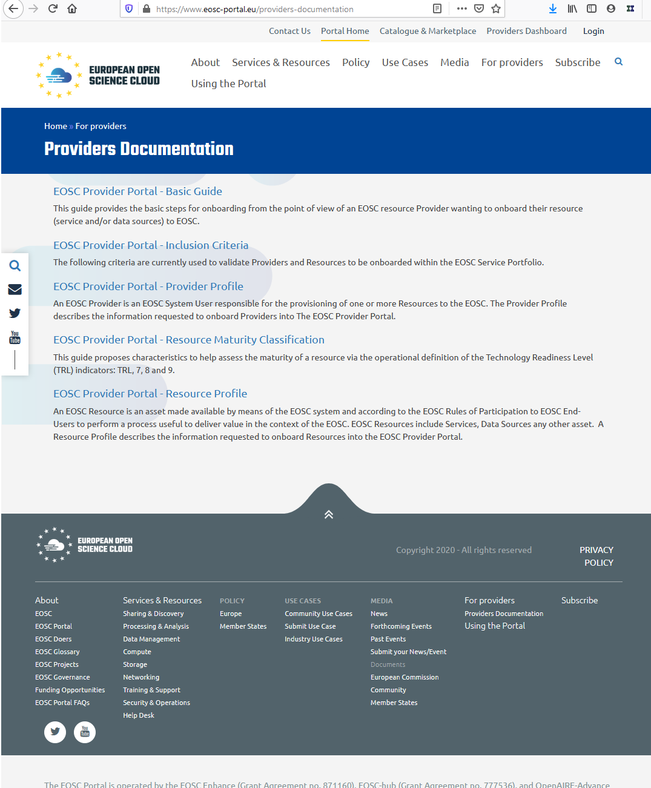
https://www.eosc-portal.eu/providers-documentation

Slide 24
Future Plans

Slide 25
WP2 Planning for 2021
Description | Date
Re-start of Onboarding Process based on v3.00 | December 2020
Re-validation of EOSC Providers and Resources in Registries based on v3.00 | December 2020-January 2021
Presentation of Y2021 EOSC Portal Development Roadmap Presentation to EC and liaising and alignment with EOSC Association | January 2021 January 2021
Agree on Change Management Process (Profiles, Onboarding, UI, etc.) | January 2021
Extension of EOSC Resource Profile for Research Products & Data Sources | March 2021
Liaising and alignment with EOSC Future | March 2021
Implementation of EOSC Quality Assurance Process | April 2021
EOSC Portal Onboarding Validation Tools | April 2021
EOSC Portal Profiles v3.xx | September 2021
EOSC Portal Onboarding Process v3.xx | September 2021
EOSC Portal Registry Migration to v3.xx | October 2021
EOSC Portal Monitoring Platform to v3.xx | October 2021
EOSC Portal Tutorials v3.xx | October 2021
ESOC Portal Release v3.xx (together with WP3/WP4/WP5) | November 2021
Cycle continue with follow-up owner | December 2021

