Slide 1
EOSC Portal Release 1 - New provider functionalities and tutorial
EOSC Enhance Introduction
Carmela ASERO – EFIS Centre

Slide 2
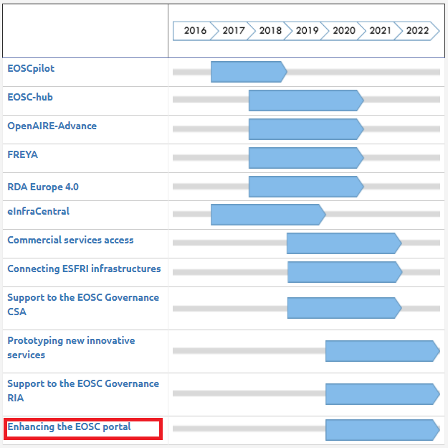
EOSC Enhance in context
Funded under INFRAEOSC-06-2019-2020: Enhancing the EOSC portal and connecting thematic clouds

Slide 3
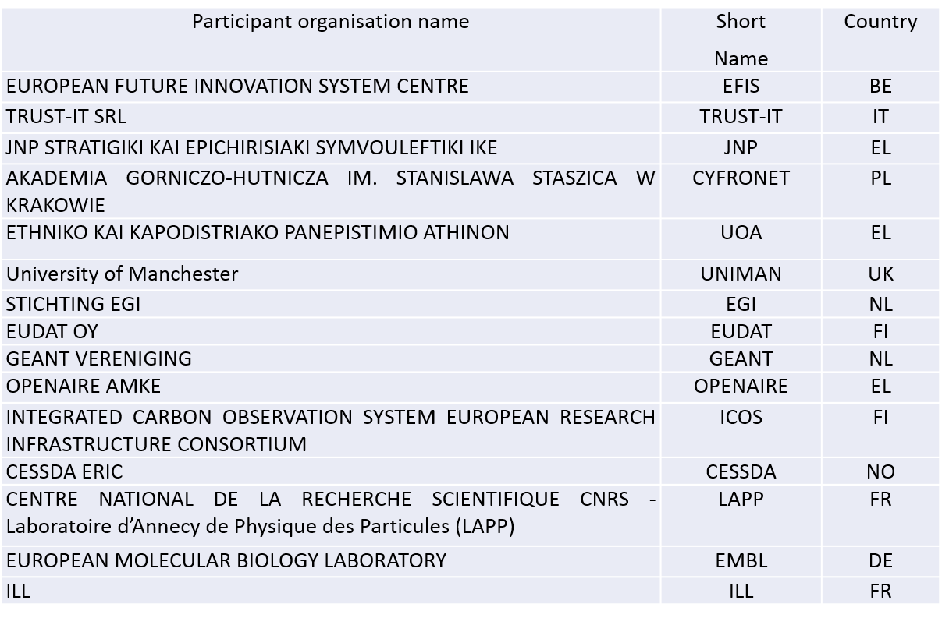

EOSC Enhance Consortium

Slide 4
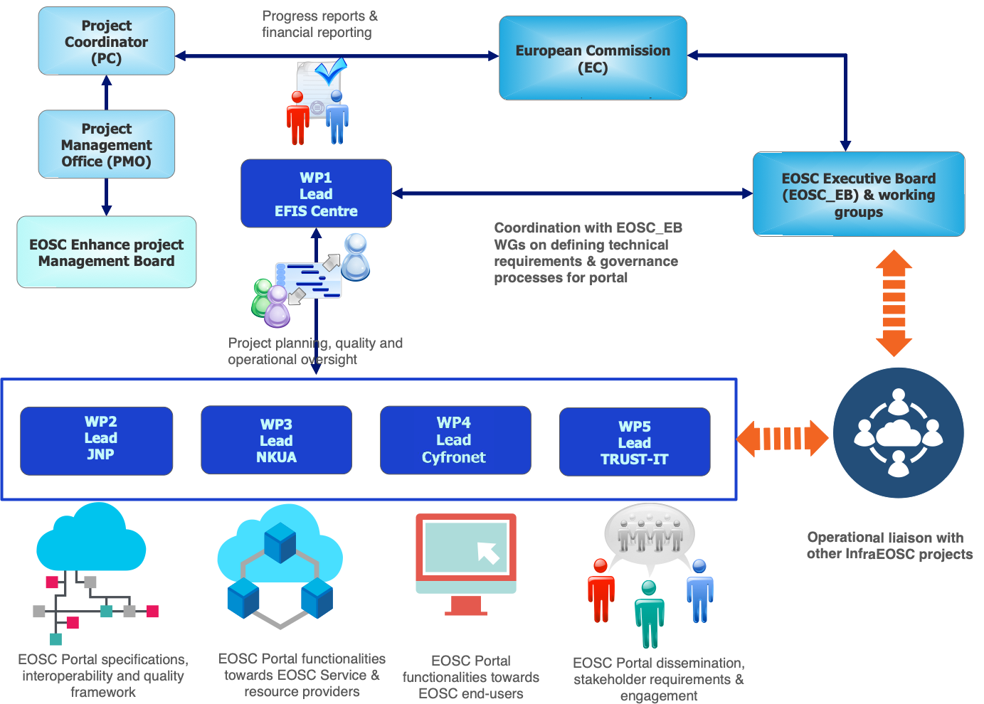
Project Structure

Slide 5
Objectives

Slide 6
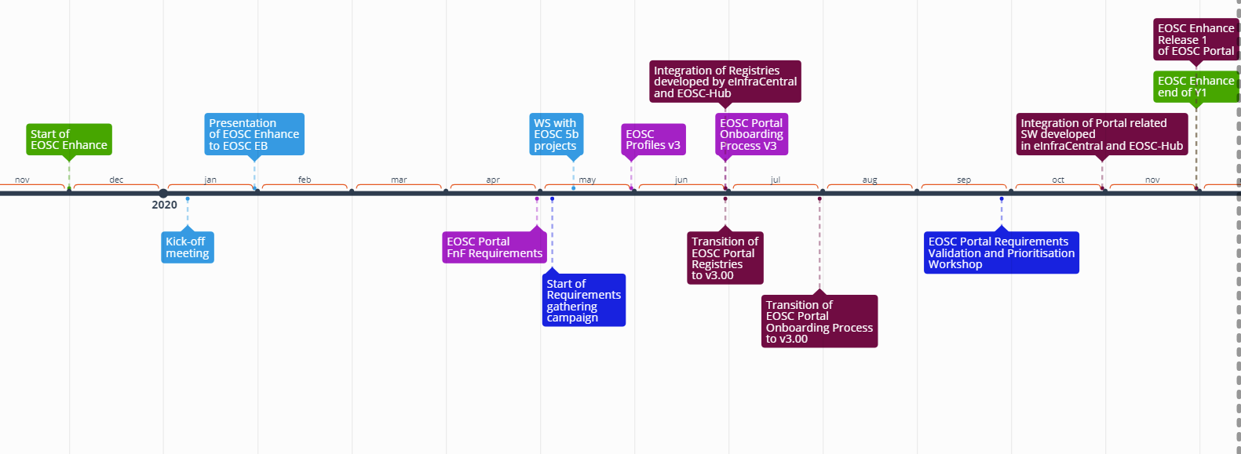
Main achievement in Year 1

Slide 7
Process toward release 1
EOSC Portal Release 1
Analysis of EOSC Portal Functional and Non-Functional Requirements
Analysis of integration models and techniques
EOSC Portal Profiles
EOSC Onboarding Process
1st Requirements gathering campaign
Requirements gathering
Validation Workshop
Analysis and adoption of new requirements
Jan 2020 Jun 2020 Dec 2020

Slide 8

Requirements Gathering
Goals
To guide the future enhancements to the EOSC Portal
To reveal insights on the needs of future EOSC users
To provide the EOSC community of actors with a better understanding on how to increase the EOSC user base
Methodology for 1st round of Requirements Gathering
Workshops: one with 5b projects held on 12th May 2020 – Session ‘EOSC Portal - focus on requirements collection’ at EOSC Hub Week on 20th May 2020
Focused interviews: with individual regional projects and RI Clusters
EOSC Secretariat Liaison Platform (e.g. participation to the Req. Gathering Interest Group with the EOSC Secretariat)
Survey on EOSC Portal Marketplace (ended on 18 September)
Requirements gathering is one of the key activities of EOSC Enhance.
EOSC Enhance assess and prioritise requirements for implementation
Opportunity to provide feedback have and will been given to the EOSC community

Slide 9
Target interlocutors
End-Users
Researchers or community managers interested in using one or more of the current or prospective services provided by the portal
Project Coordinators interested in understanding how to reflect their strategic plan into the EOSC Portal future developments
Stakeholder Engagement leaders interested in leveraging on the portal to widen the user base of their project
Training managers willing to share their training modules with a wider audience and looking for complementary training suitable for their projects
Communications Managers willing to exploit the portal to disseminate the outcomes of their project
Service Providers
Aggregators technical managers (e.g. RIs, Clusters, thematic clouds) interested in exploring how to make their existing resources (e.g. data, services) part of the EOSC portal
E-Infrastructure managers interested in providing compute, storage, networking resources via the EOSC Portal
Public and Private service providers willing to make their services and products part of the portal
Notes:
The stakeholders that we are addressing in this first consultation phase are the EOSC-related projects, those contributing to shaping the future EOSC with a particular focus on the cluster projects (ESFRI clusters and thematic clouds). In 2021, when an improved version of the portal will be available, we will open a wider consultation targeting researchers and academic institutions.

Slide 10
Timeline
Year 2
Continuation and widening of the requirements gathering activity towards the EOSC community
Collaboration and synergy with new Infraeos-03 and -07 projects for iterative improvement of the process, prioritisation and implementation
Release 2
Regular minor bug-fixing releases and 2 major new releases (mid 2021, end of 2021) with:
  Analytics and Visualization services for providers regarding the usage of resources
  Analytics and Visualization services towards funders and policymakers regarding the evolution of EOSC catalogue
  Integration of order management services (for providers)
  Update of the Onboarding process for the support of aggregators of resources
  Update of the APIs to the new concepts introduced by the extensions to the EOSC Profiles

